Slide 1
Blood Bank Management system
Project made by: Muhammad Ali Saleem, Fawwaz Wajeeh ahmed, Hanzala Raza

Slide 2
ERD diagram
table_admin
table_stock
st_id
a_password
a_id
a_name
St_rec_fk_id
St_bloodgroup
st_quantity
donates
adds
table_person
Per_ad_fk_id
per_id
table_recieve
per_name
per_gender
r_id
per_phone
r_date
per_dob
r_pid_fk
per_address
per_bloodtype
r_hospital
r_quantity

Slide 3

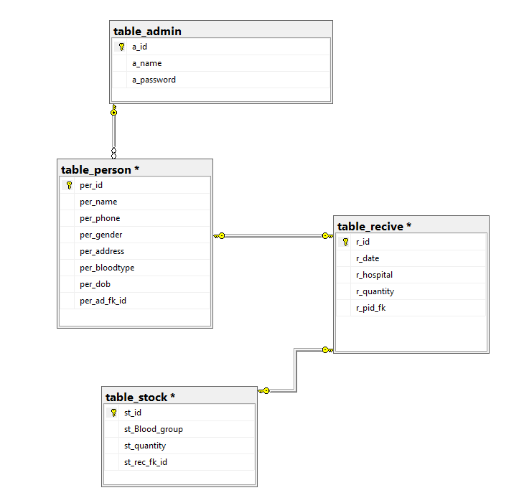
Relation Schema Diagram

Slide 4

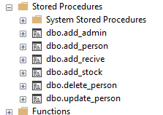



Store Procedure Used in the poject

Slide 5
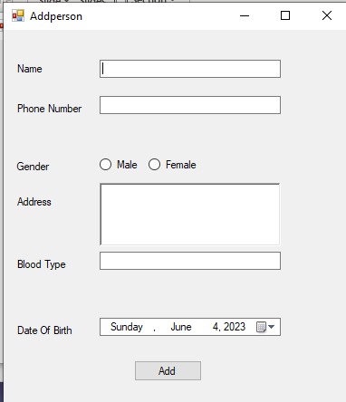
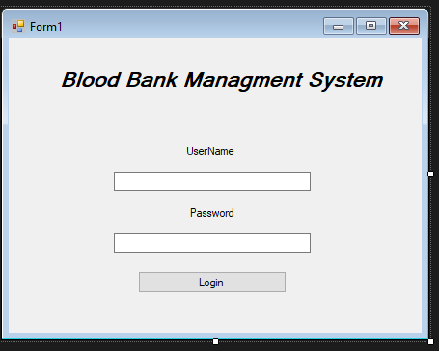
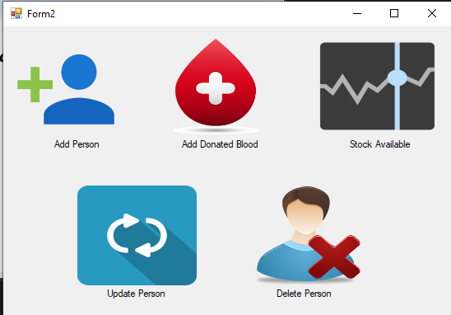
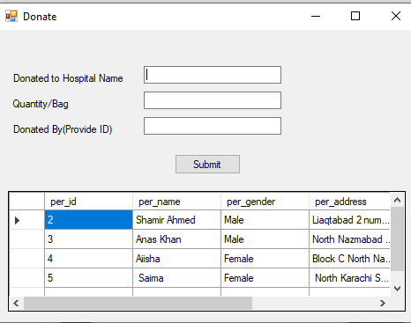
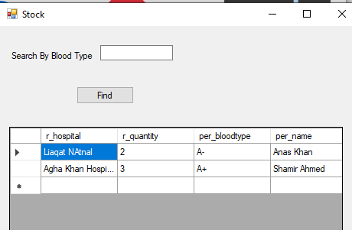
Forms used in our project

Slide 6
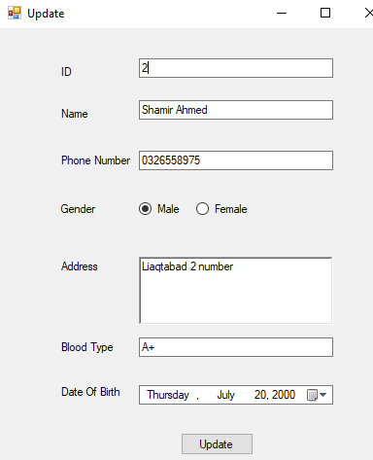
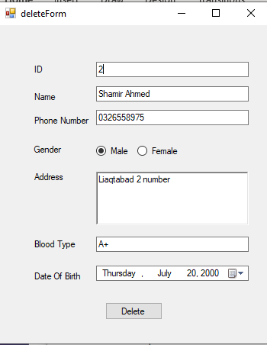
Forms Used

Slide 7
Connection from WinForms to database
We have to provide the NAME , CONNECTION STRING PATH and PROVIDER NAME
We have to use references like System.Data.SqlClient to access the SQL classes

Slide 8
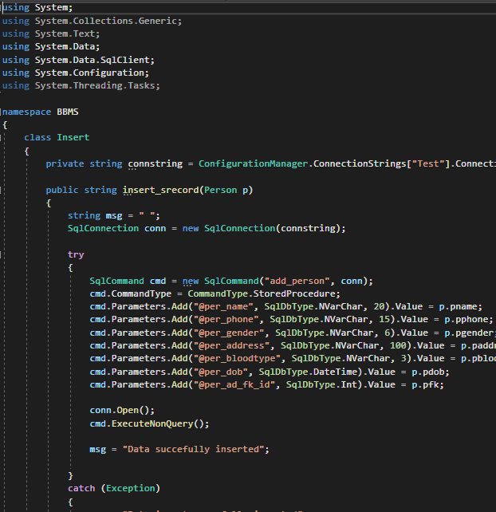
Code for insert passing the store procedure
We have to use references like System.Data.SqlClient ,System.Data,System.Configuration to access the SQL classes
We have passed the store procedure add_person in which the insert querry is encapsulated and pass the column name of person table to insert the data into database.

Slide 9
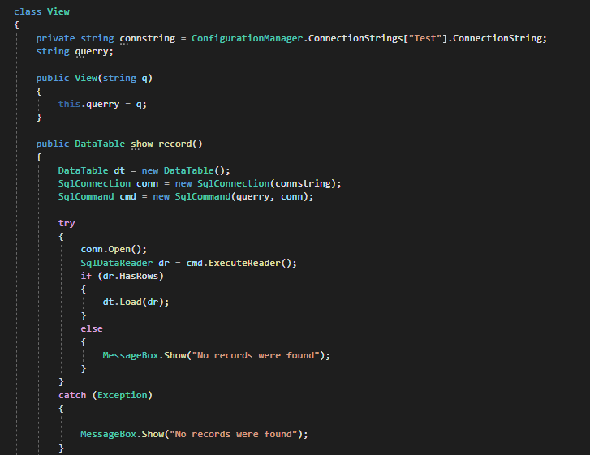
Retrieving the data from Database
We made view class to used SqlDataReder class to access the database and retrieve the data.
To retrieve the data we are using ExecuteReader() method.

Slide 10
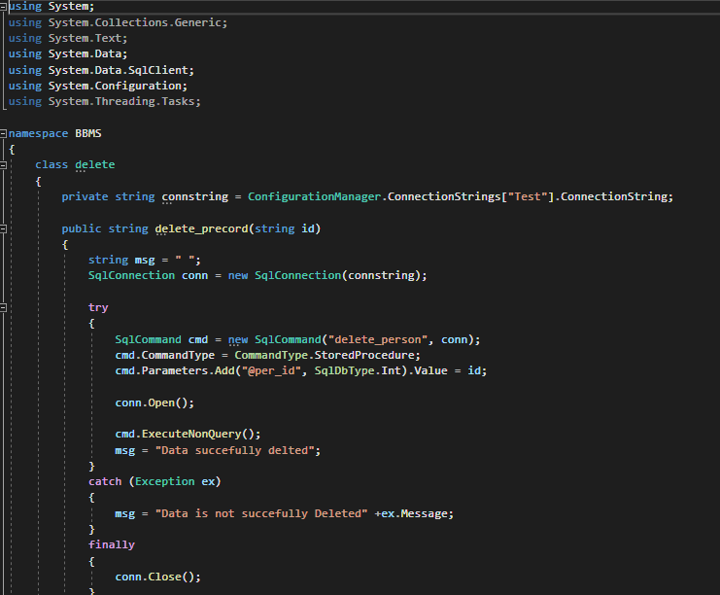
Delete the record
We passed the store procedure delete_person and we are only retrieving id so that we can delete the record of the person.

Slide 11
Thank you

